Slide 1
Unit 6: Preparedness
Unit 6:
Preparedness

Slide 2
Unit Terminal Objective
Explain the Senior Official's role in preparedness.

Slide 3
Unit Enabling Objectives
List Senior Official responsibilities in preparing for an incident.
List website resource for FEMA doctrine, guidelines, and additional training.

Slide 4
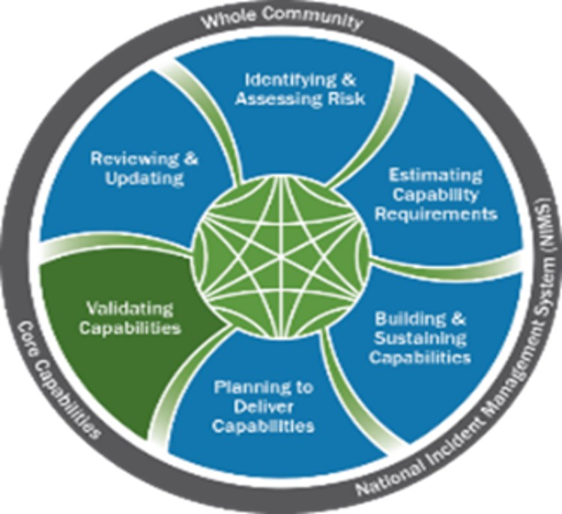
Preparedness

Slide 5
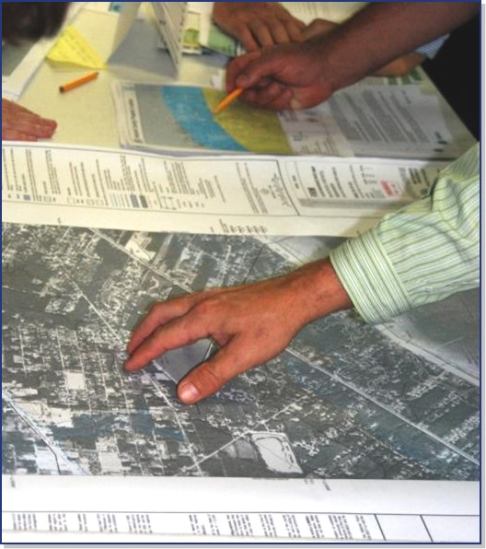
Check Plans, Policies, and Laws
Do your agency's/jurisdiction's preparedness plans, policies, and laws:
Align with NIMS terminology and systems?
Cover all hazards?
Include delegations of authority (as appropriate)?
Include up-to-date information?

Slide 6
Establish Communications and Information Systems
Do you have established systems for:
Describing, inventorying, requesting, and tracking resources?
Activating and dispatching resources?
Managing volunteers?
Demobilizing or recalling resources?
Financial tracking, reimbursement, and reporting?
Do you have mutual aid and assistance agreements for obtaining resources, facilities, services, and other required support during an incident?

Slide 7
Establish Communications and Information Systems
Are protocols and procedures in place?
Can responders from different agencies or mutual aid and assistance partners communicate with one another?
Do you have a plan/budget for maintaining and replacing your emergency communication systems?

Slide 8
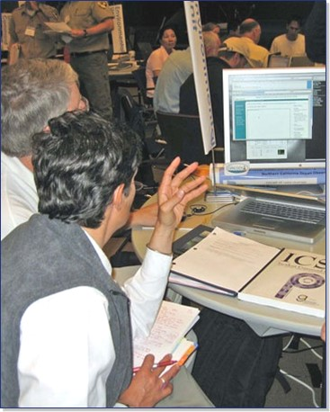
Training, Credentialing, and Exercising
Do you have sufficient qualified personnel to fill ICS, EOC and JIS positions?
Can you verify that personnel meet established professional standards for:
Training?
Experience?
Performance?
When was the last tabletop, functional, or full-scale exercise that practiced command and coordination functions? Did you participate in that exercise?

Slide 9
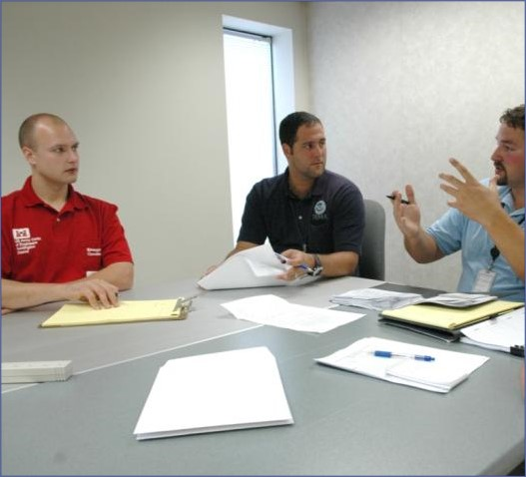
Continuous Improvement
Incident debriefing
Post-incident critique
Post-incident analysis
Corrective Action Report/After Action Report

Slide 10
Additional Resources
NIMS Doctrine and Supporting Guides and Tools - https://www.fema.gov/emergency-managers/nims/components
ICS Resource Center - https://training.fema.gov/emiweb/is/icsresource/
Additional NIMS Training - https://training.fema.gov

Slide 11
Objectives Review
What are the Senior Official's responsibilities when preparing for an incident?
What websites provide resources for FEMA doctrine, guidelines, and additional training?

